Slide 1
TELECOM CHURN
ASSIGNMENT
Murtaza Bookwala

Slide 2
After cleaning the Dataset and eliminating unnecessary data on which the analysis won't be working, we came to
A result on which we performed Univariate and Bivariate Analysis by plotting graphs such as bar graphs and
Scatterplots.
After that we enter the phase of Model building and testing.
Then the decision tree is made
Then we enter the Random Forest Classifier phase where all the values from Decision Tree are considered and
Combined and made in one outcome.
So, at the end with PCA (Principal Component Analysis) the result turned out to be approx 81% and without PCA
The model showed good results too.
So, we will go further ahead with simple model such as logistic regression with PCA as it explains the
important predictor variables as well as the significance of each variable.
The model also helps us to identify the variables which should be act upon for making the decision of the to be churned
Customers.

Slide 3
Recommendations are:
Target the customers, whose minutes of usage of the incoming local calls and outgoing ISD calls are less in the action
phase (mostly in the month of August).
2. Target the customers, whose outgoing others charge in July and incoming others on August are less.
3. Also, the customers having value-based cost in the action phase increased are more likely to churn than the other
customers. Hence, these customers may be a good target to provide offer.
4. Customers, who's monthly 3G recharge in August is more, are likely to be churned.
5. Customers having decreasing STD incoming minutes of usage for operators T to fixed lines of T for the month of August
are more likely to churn.
6. Customers decreasing monthly 2g usage for August are most probable to churn.
7. Customers having decreasing incoming minutes of usage for operators T to fixed lines of T for August are more
likely to churn.
8. roam_og_mou_8 variables have positive coefficients (0.7135). That means for the customers, whose roaming outgoing
minutes of usage is increasing are more likely to churn.

Slide 4
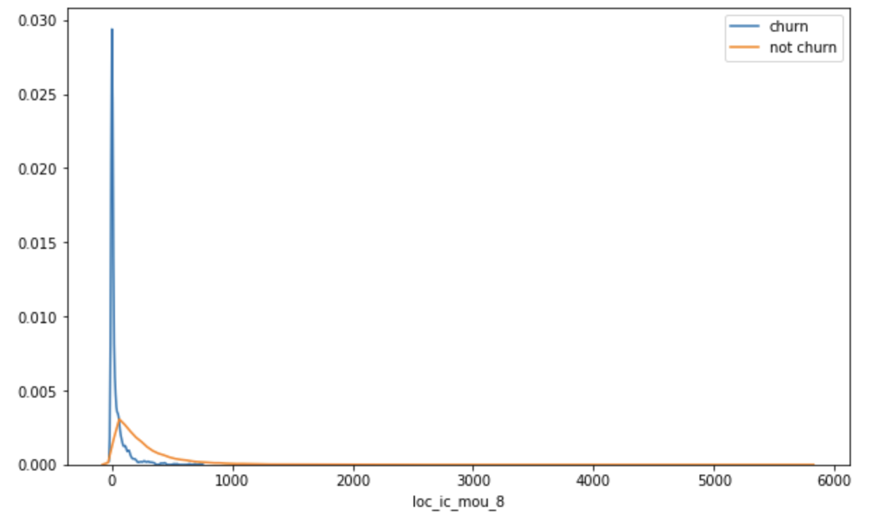
We can see that for the churn customers the minutes of usage for the month of August is mostly populated on the
lower side than the non-churn customers.

Slide 5
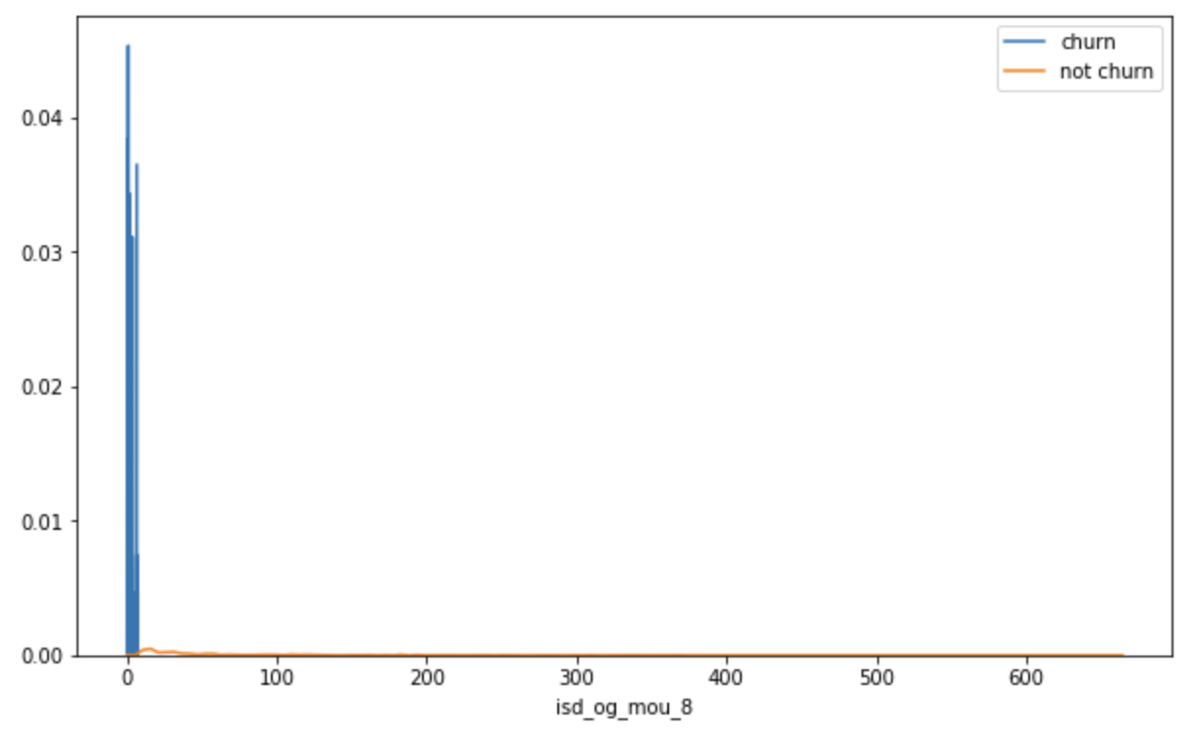
We can see that the ISD outgoing minutes of usage for the month of August for churn customers is densed approximately
to zero. On the other hand for the non-churn customers, it is little more than the churn customers.

Slide 6
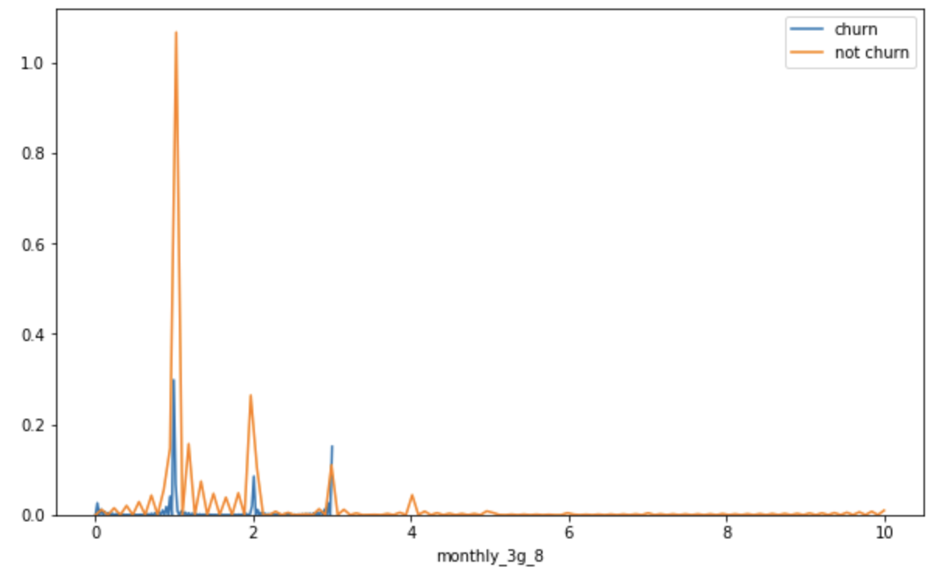
The number of monthly 3g data for August for the churn customers are very much populated aroud 1, whereas of
non churn customers it spreads across various numbers.
Similarly, we can plot each variables, which have higher coefficients, churn distribution.

